Slide 1
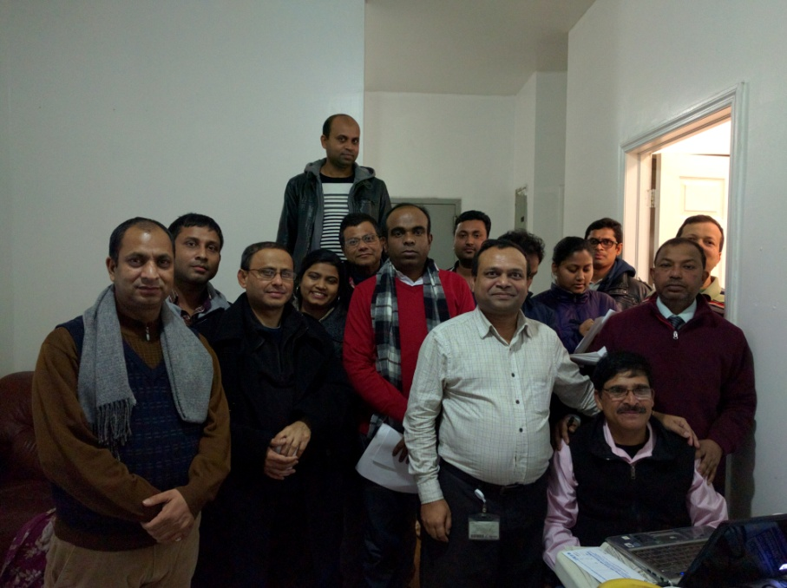
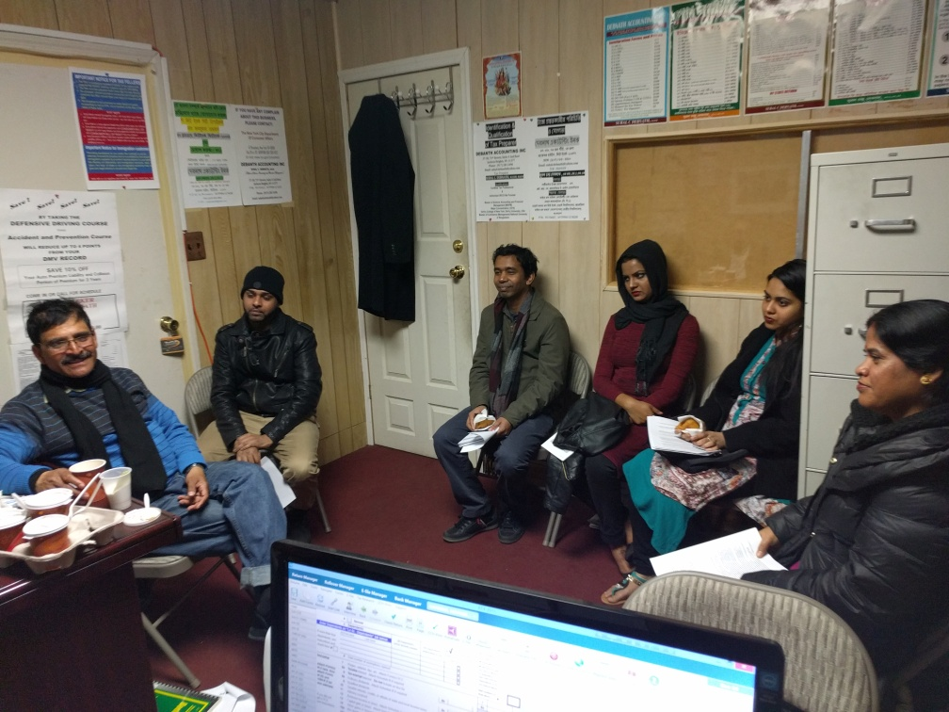

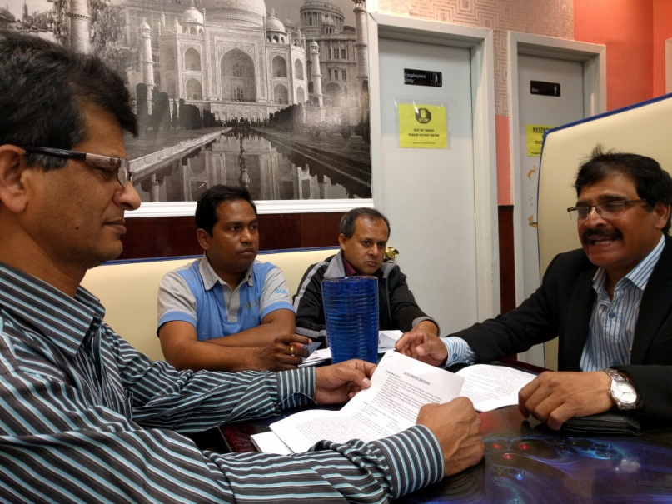

Presentation on Exam Technique ()

Slide 2
Introduction
Presenter
Organizer
Participants

Slide 3
Presentation Goal
Introduction and Overview
Study Materials Book/Guide
Study and Prepare for Exam
Participate in Exam, Follow Rules and Learning
Pass the Exam with Commendable Score

Slide 4
Whey we Need Move/Development
What job aid is doing for you and why
Current Situation VS Planned (Home, Promotion ETC)
Why We Need Move and Development
  Promise to our Keen (Before arrival to USA)
  Future comfortable life family /own children set up
  Relaxes and Religious
How We developed
  Develop Through Children
  Earned and go for Small Business
  Have a comfortable job and retire
  Further Education and Grow
Obtain City Job
  Traffic Enforcement Agent
  School Safety
  Correction
  Other City jobs
Benefit of City Job
Moving Ladder/Career Progression
Health and Mental Satisfaction

Slide 5
Qualification and Exams Systems
Candidate Qualification (education, Paper, Physical)
What in the Test
  At least 50% type of questions are common in all Exams
  Questions related to the Job
  Questions Related to the Standard of the Job
How Test Taken
  Multiple Choice Test (in paper/Computer)
  Face to Face Interview
Candidate List Generation (City)
Physical/Psychological/Brief Call
Recruitment and Training
Posting to Jobs

Slide 6
Exams and Recruitment
Self Confidence: Capability, Potential, Attitude, Action
Decide to move for Development
Allocation of Time for Study and Development
Research for Potential Opportunity (Open Exams, Monthly Exams)
Apply and Information Collection
Information Collection
  Books/Guide Collection
  Reading and Practice
  Ask question and obtain Assistance
Take preparation and undertake the Test
Practice Questions Areas (Multiple Choice)
Score in Exams
  Achieve Common Questions 40% (Math's and Simple questions)
  Reading and Special Attention will have 20%
  Information Collection 10%
  Special Technique for Exams 10% ( Job Aid and DR )

Slide 7
Testing Areas
Written Comprehension: These questions will test are you able to understand written sentences and paragraphs. = Most Job Needed
Written Expression: The test will assess your ability in conveying a clear, written in English message. = Most Job Needed
Memory questions: Measures your memory for information expressed in words, numbers, pictures and procedures. = Depend on the Test and Position
Problem Sensitivity: These questions will test how well you identify a problem and its elements, and can you detect an error. = Most Job Needed
Deductive Reasoning: You’ll be tested on your ability to apply general rules to specific problems and to come up with a logical answer. = Most Job Needed
Inductive Reasoning: Questions in this test will assess your ability to combine together separate pieces of information or specific answers to problems, thus forming a general rule or conclusion. = Most Job Needed
Information Ordering: The questions will test your capability to comply with a rule or a set of rules and to arrange things or actions in a certain order. For example, to perform mathematical or logical operations and to arrange numbers, letters, words, pictures, procedures, sentences, etc. = Most Job Needed
Spatial Orientation: Here you will be tested on your spatial orientation aptitude, meaning the spatial relativity between an object and yourself. = Most Job Needed
Visualization: The questions measure your visual prediction qualities. To answer these correctly you’ll be required to be able to form mental images of rearrangement and moving around of objects or patterns. = Depend on the Test and Position

Slide 8
Exam - Memorize
Use your best memorize technique
-Take deep breath
-Snapshot the scene
-See every details and memorize
-Find small clews, letters, no, act, conditions etc
-Memorize
Before exam practice in home few times. Usually 10 questions

Slide 9
Exam Planning
Read details instruction of the test carefully
Identify time according to the number of questions to be answered.
You should try to answer all questions (regardless)
- Allot less time for your favorite and easiest questions
-Try to read questions twice before answer
- Avoid answering in pattern(Example C then D then C (when pattern came to mind change to other type of questions and come back to the left one)
Find the word between the sentence
Find the specific questions they asked for

Slide 10
Find Special Words
Find the requested special words and prepare answer keeping the words in mind
Positive Words: Most, Nearly, Mainly, Wise, Likely, Best, Except, First, Usually, Primarily, Alternative, Principal, Solely, Inversely, Nearly, Generally, Must and many more
Negative words: Poor, Least, Last, Not, Undesirable, Don’t, Unwise
Spot these punch words which are in Bold format and prepare answer according to the punch word. Example: Questions will be which one is the most suitable or which is the least preferable. Always mindful of these punch word.

Slide 11
Best Technique
Utilize full allotted time on the exam. Do not leave early
Allot time for each questions and manage it
Request for White Paper and Pencil (Put ABCD) for easy answer for Paragraph type questions
Answer your comfort zone first/Answer short questions
If you feel uncomfortable with any questions then leave that for sometime and come back later to answer
Answer mathematical questions (if you feel comfort)
Leave map, graph/paragraph type questions for later to answer
English or vocabulary questions can be answered as comfort
If you have doubt follow elimination process
If you have time then check your answer (revised/revisit) but feel constration for changing previous one.

Slide 12
Group Discussion
Break for Tea, Group Discussion

Slide 13
Elimination Process
Write in the loose paper (if given by the authority) ABCD fist and from the 4 answer, first take out/cross out the least appropriate 2 answers. Now you have most possible 2 answers and out of this 2 answer 1 is correct. Read second time and circle the most appropriate one which one you think the correct answer. Follow TV series example.
When you revisit the answer, do not change the previous answer easily. Check twice to cross the previous answer.
Try to find answer from the questions, some times answer clue is given in the questions

Slide 14
Example 2 Elimination Process
The instructor gives the class the following example: Officers who observed a motorist driving erratically stopped him and asked to see his license and registration. The license has been revoked, although the car's registration appeared valid. What should the officers do next?
A) Confiscate the driver's license.
B) Prepare a Seized Driver's License Receipt/Report.
C) Arrest the driver and transport him to the precinct.
D) Direct the driver to park the vehicle in a legal space.

Slide 15
Exam Preparation
  Book your exam days with center early
  Study the exam guide at least twice
  Have a sound sleep at night
  Please park all your ongoing issues before exam.
  Concentrate on the exams only
  Arrived at least 30 minute early to the center
  After sit down close your eyes and concentrate. Do meditations (if you know)
  Change your seating position when you fell board or sleepy
  Take a few second pause and closed eyes if you feel uncomfortable
  Do not panic. If you panic then you will not be able to concentrate. It is a exam not court room.

Slide 16
Good Luck with Your Exams!
Please feel free to contact me if you have questions, comment or concern at jalilraj@gmail.com.
Tel: 6462879964
Thank You
=============================
Question and Answer
  .

Slide 17
Special Technique Answer
Police Officer Dennis Hui and John Kitsakos were patrolling in their police car in the 65th Precinct at 10:15 A.M. on October 3, 2004. They came upon the scene of a traffic accident at Avenue C and 30th Street, which had occurred five minutes earlier
A. Which one of the following is the correct license plate number and description of Mrs. Cloris’ vehicle?
  A. NY plate #319GAZ, white 2001 Chevrolet van
  B. NY plate #319GZA, red 2003 GMC station wagon
  C. NY plate #319GAZ, red 2003 Chevrolet station wagon
  D. NY plate #319GAZ, white 2003 Chevrolet van
B At what time did the traffic accident occur?
  A. Before 10:00 A.M.
  C. 10:15 A.M.
  B. 10:10 A.M.
  D. 10:20 A.M.

Slide 18
Questions Memorization Test
How many human on the Picture
How many Hut in the Scene
Any water coming from Tube well
How many people in the Bare body
How many people were Glasses
Date of Picture taken
Time of Picture taken
==========
How many cone in the Picture
How many car in the Picture
How many commercial Car in the Picture
How many pole in the picture
What color of the Cap
How many back pack in the Scene
How may walking sign in the Scene

