Slide 1
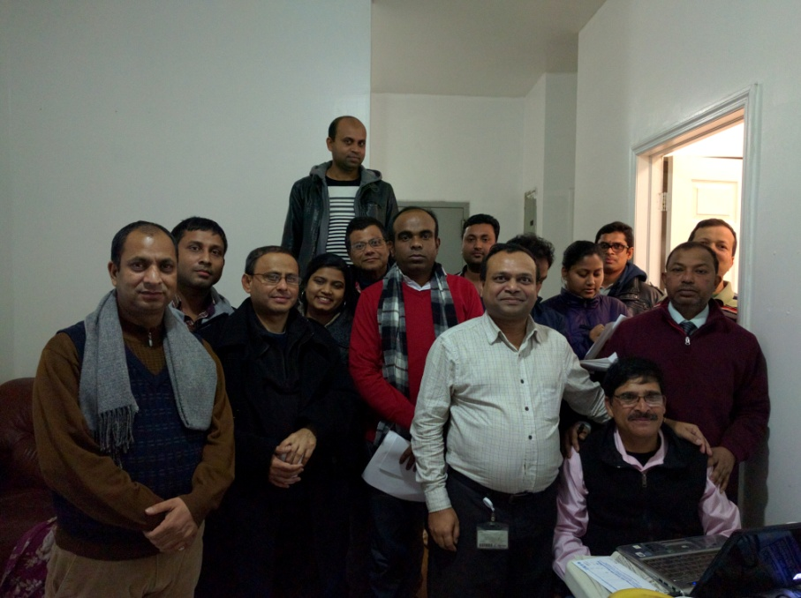
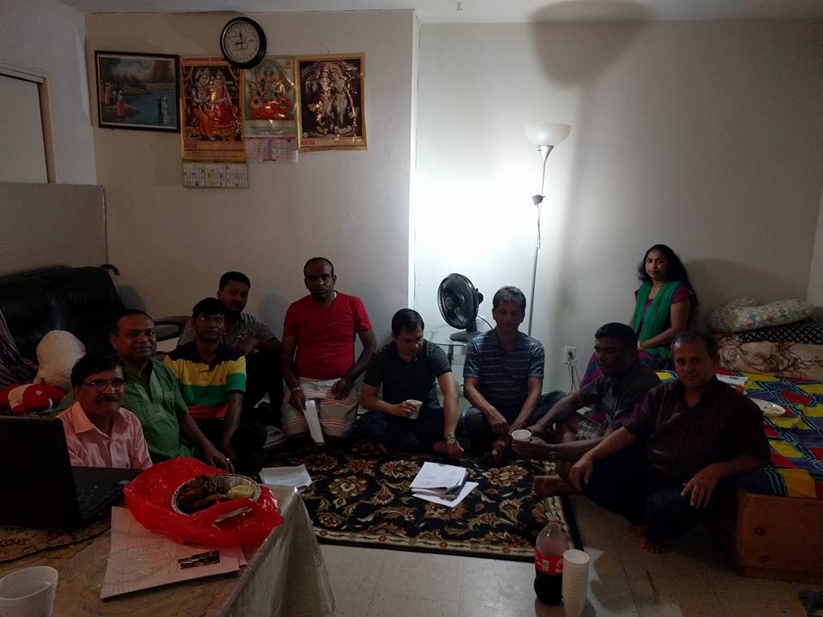
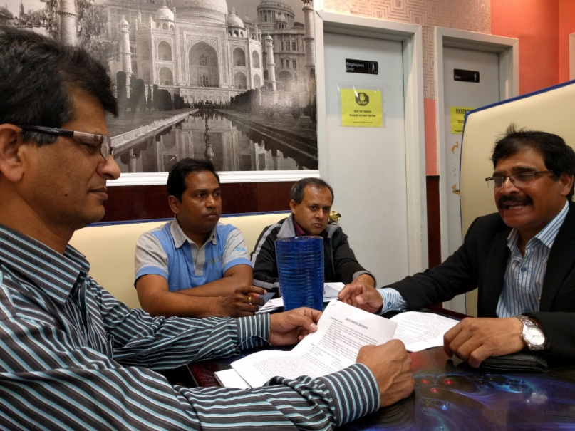
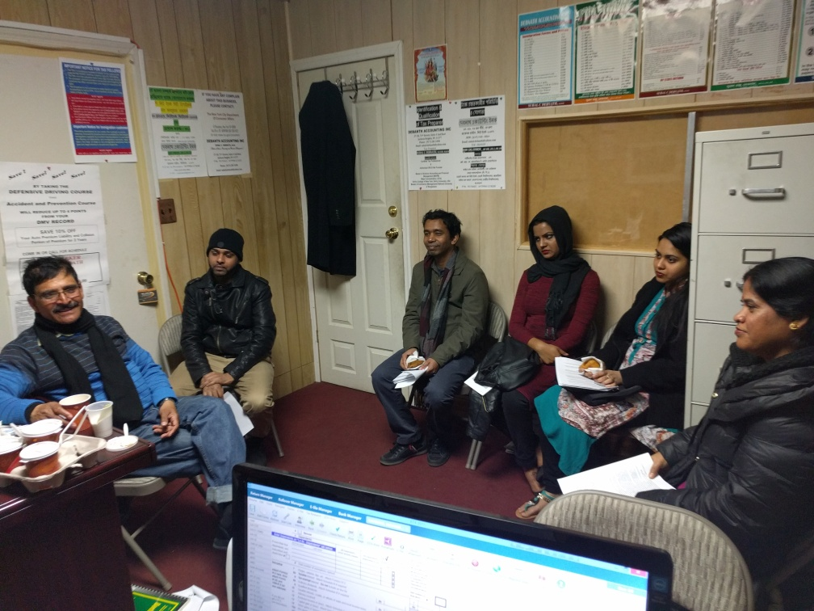
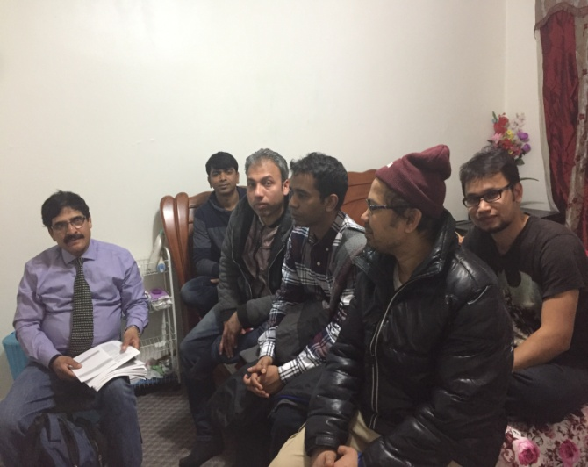
Presentation on Exam Technique ()

Slide 2
Introduction
Arrival and Signing
Presenter (exp, why,)
Organizer
Participants

Slide 3
Safety and Attitude
About Venue: Need assistance, Safety Aspect, Escape Areas
Copies of Documents: Available in Web / Take Photocopy.
Everyone is Potential: Need to Change
Potential, Attitude towards Goal, Action Success.
Encourage to have Attitude
(Work ethics and Attitude is important
Talent and ability can open the first door but it can not open the last or second door until and attitude forces to do the work)

Slide 4
Goal of Organizers
Objective: Help Community
Interest: All assistance are Voluntary
Why: Self Satisfaction
We wish to serve community
Outcome: Better Occupation for People
User: Have better work, better life, better Community
Information is Knowledge, Knowledge is power

Slide 5
Presentation Goal
Who and Why:
Interest Group
Willing to have help
Fixed target
Willingness for Work
Prepare for Exams:
Books Collection
Study properly
Determination to success
Trainer:
Provide soft Technique
Guide on Study
Motivation
Provide High Scoring Technique
Taking Exams/Success
Physical Aspect = Freshness
Mental Aspect = Devotion
Utilization of Time
Avoid Panic (come and Cool)
Answer Correctly
Answer All
Outcome:
Pass the Exams and wait for Call
Eligibility of other Exams (50+ 20+15 =85)
Rate our output by mail, (Call/E-mail/Insist Others, )
Mentioned others and encourage to take Assistance from Others

Slide 6
2. Organizer Assistance Coverage
Motivate towards exams
Guide to have good exam preparation
Provide proven tools to help good score
Further Assistance to take similar exams
Assistance Matrix ====================================
Candidate Study Training (Hypothetical)
Score 40-50% 20……% 0% 60-70 Before
Score 40-50% 20-30% 10-15% 70-85%

Slide 7
Topics to be Discussed
MTA Job Aspect (Benefit, Money, Position, Flexibility)
Organizer Assistance coverage (Hypothetical)
Study Technique
Identifying Questions
Proper Utilization of Time
Answering Tips
MTA Questions and Answer
Physical Awareness (sleep, Arrival, Mental)
Controlling Panic

Slide 8
Testing Areas
Written Comprehension: These questions will test are you able to understand written sentences and paragraphs.
Written Expression: The test will assess your ability in conveying a clear, written in English message.
Problem Sensitivity: These questions will test how well you identify a problem and its elements, and can you detect an error.
Deductive Reasoning: You’ll be tested on your ability to apply general rules to specific problems and to come up with a logical answer.
Inductive Reasoning: Questions in this test will assess your ability to combine together separate pieces of information or specific answers to problems, thus forming a general rule or conclusion.
Information Ordering: The questions will test your capability to comply with a rule or a set of rules and to arrange things or actions in a certain order. For example, to perform mathematical or logical operations and to arrange numbers, letters, words, pictures, procedures, sentences, etc.
Number Facility: The ability involving the degree to which adding, subtracting multiplying and dividing. ESPECIAL FOR MTA
Spatial Orientation: Here you will be tested on your spatial orientation aptitude, meaning the spatial relativity between an object and yourself.
Mechanical Aptitude: The ability to understand and apply mechanical concepts and principles to solve Problems. Example how a train break effect on the job. ESPECIAL FOR MTA
Visualization: The questions measure your visual prediction qualities. To answer these correctly you’ll be required to be able to form mental images of rearrangement and moving around of objects or patterns.

Slide 9
3. Study Technique
Collect Book original (not photocopy)
Take white paper and draw Answer Sheet
Do not put any answer marks on book
Study 1 -2 chapter a day
Review your answer and identify mistake
Review your mistakes, Understand, Correct
Do not Memories but Understand
Practice Answering Tips
Make Study Group (if possible)
Repeat the Process

Slide 10
4. Identifying Questions
Identify Punch ward in the question
Read Full Question first before Answer
Identify the requirement (Single Answer vs. None of the Above, All of the above/Except)
Identify Restrictions Negative/Positive wards never, always, most, nearly, mainly, Poor, Least, Last.
Try to draw Summery of Answer on memory
Read all choice before Answer
Don’t guess too soon
Be careful about jargons in the questions
Try to find answer from the questions, some times answer clue is given in the question
When Doubt follow Other Soft Rules

Slide 11
5. Time Management -Exam Planning
Read details instruction of the test carefully
Allocate time according to the number of questions to be answered.
You should try to answer all questions (regardless)
- Allocate less time for your favorite and easiest questions
-Try to read questions twice before answer
Avoid answering in pattern(Example C then D then C (when pattern came to mind change to other type of questions and come back to the left one)

Slide 12
5. Time Management - Best Technique
Utilize full allotted time on the exam. Do not leave early
Answer your comfort zone first (Short/Mathematical/Comfort Zone)
If you feel uncomfortable with any questions then leave that, come back later to answer
Leave graph/paragraph type questions for later to answer)
English or vocabulary questions can be answered as comfort
If you have doubt follow Soft Process )Guesses/Elimination/Cross)
If you have time then check your answer (revised/revisit)
When you revisit the answer, do not change the previous answer easily. Check twice to cross the previous answer.

Slide 13
7: MTA Train Operator Exams
BE mindful:
Safety is THE number one Priority
Find answer in the Questions
Answer as per the reporting laws (Do not guesses)
Follow signals not the time
Remember Signal Laws/Buzz (NA-Talk)
Buzz/Horn is important and when, how, number
Write up the Rules and Remember
Given Big Rules Followed by Questions – Ans Last

Slide 14
7: MTA Train Operator Exams
BE mindful:
Cautions about Answering When Found ward” Must Not Be, Least, Not, Minimum, Most Nearly, Best, must be, and in BLOCK LETTER.
Used Commonsense Prioritizing Safety when You Stuck
Caution about Signal Color, Ward, Message and Picture (do Not compare with Road Light)
Understand Code “Fouling, R6, 8 Car etc. Write and Remember
Take Note of Points, Light Color and Process to remember
Remember MTA is an Organization, Follow Procedures
Remember Terminology, Next Station/ terminal, Despatcher/Road Car Inspector, Control Center Desk Superintendent

Slide 15
6 & 7. Good Gausses and Elimination Process
Good Gausses: You do not know correct answer
Read 2/3 times the Questions and answer. Find the best suitable one , sound correct appeared to be correct
Example:
A Conductor must not close the door of a train in the Station until they have fully operated for at least
Five Seconds
Ten Seconds
Five seconds in the front and ten seconds in the rear
Ten seconds in the front and five seconds in the rear

Slide 16
6 & 7. Good Gausses and Elimination Process
Crosses Out Technique/Answer in Questions:
Write in the loose paper (if given by the authority) ABCD first and from the 4 answer, first take out/cross out the least appropriate 2 answers. Now you have most possible 2 answers and out of this 2 answer 1 is correct. Read second time and circle the most appropriate one which seems correct.
A Train operator observing that the tower operator has set up the wrong route should signal with ___ whistle blast(s)
One Long B. Two Short C. Three Short D. Four Short

Slide 17
6 & 7. Safety First Not time or Gausses
Always mindful about safety first while answer:
If a Train Operator, without authorization, fails to make scheduled station stop, the conductor must, FIRST
Pass One long buzzer to the train operator
Operate an emergency brake valve at the next station that the train stops at end find out why the train operator skipped a station
Immediately operate an emergency brake valve
Notify the Control Centre and investigate the cause
( If Process than D, If forgot than B, If cooperative than C, Safety than D

Slide 18
6 & 7. Elimination Process
Elimination Process means read the question first and than eliminate first tow answer which seems not right. Now you have Two answers, Read the questions second time and find the correct one from rest two answers:
If for any reason, some side doors of the train fail to open, the conductor must allow_____ for customers to detrain and entrain.
Thirty Second
Ample opportunity
Twenty Seconds
Fifteen seconds in the rear section and twenty seconds in the front section
    Follow TV Series Guide.

Slide 19
7. MTA related language rules
Example:
Buzz, Signals, Rule, FT 10, End of Signal Control, GT 10, 6, 4 Car,
MPH, Out of Service, R6, FOULINGR$$, SMME Car, R68, BCO, ME 23 brake
15-pound Brake
ETC

Slide 20
8 & 9 Physical and Controlling Panic
  Have a sound sleep at night and have good food, Drink water as you require
  Be prepared emotionally and physically
  Please park all your ongoing issues, Anxiety, Hardness, before exam.
  Concentrate on the exams only, Try to do your best
  Arrived at least 45 minute early to the center, Take deep breath
  After sit down close your eyes and concentrate. Do meditations (if you know)
  Change your seating position when you fell board or sleepy
  Take a few second pause and closed eyes if you feel uncomfortable
  Do not panic. If you panic then you will not be able to concentrate. It is a exam not court room.
  If you become panic, Change Seating position, closed eyes and Sharpen your memory

Slide 21
Good Luck with Your Exams!
Please feel free to contact me if you have questions, comment or concern at jalilraj@gmail.com.
Tel: 6462879964
Thank You
=============================
Question and Answer
  .

