Slide 1
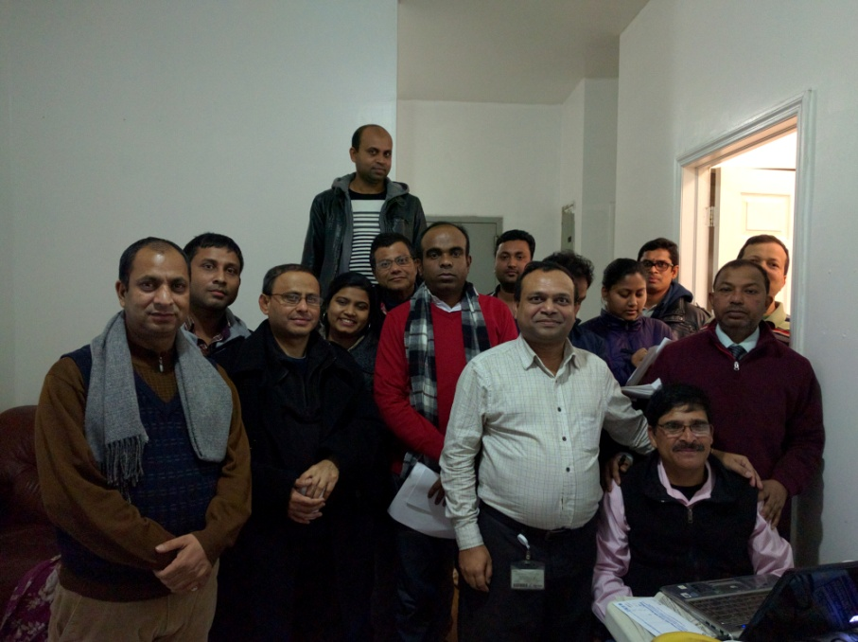
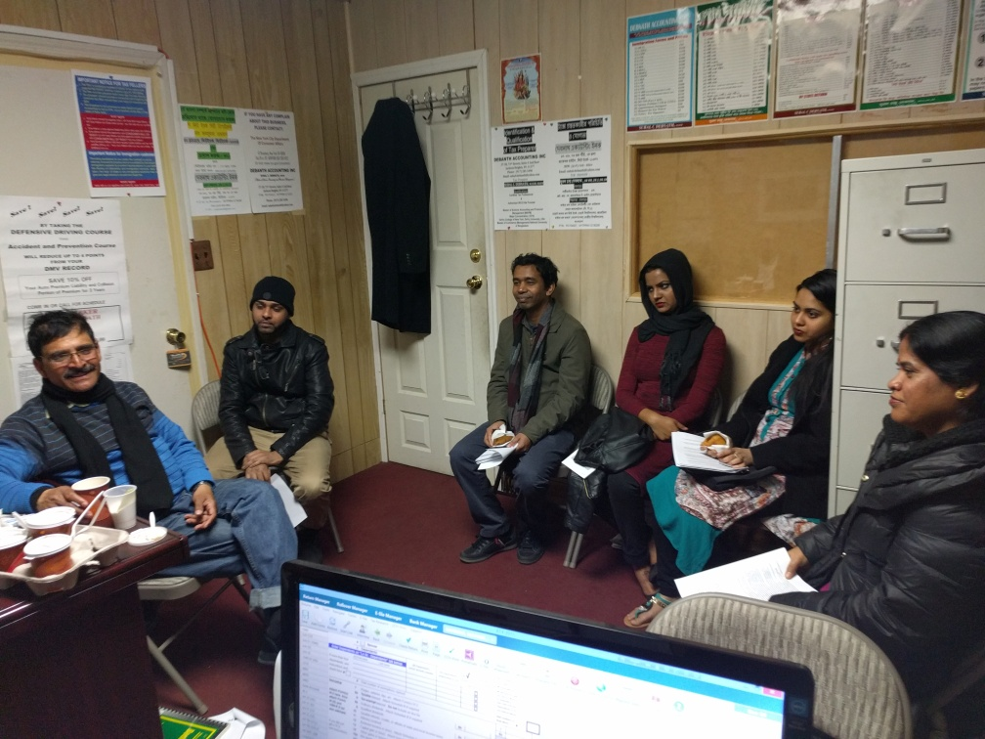

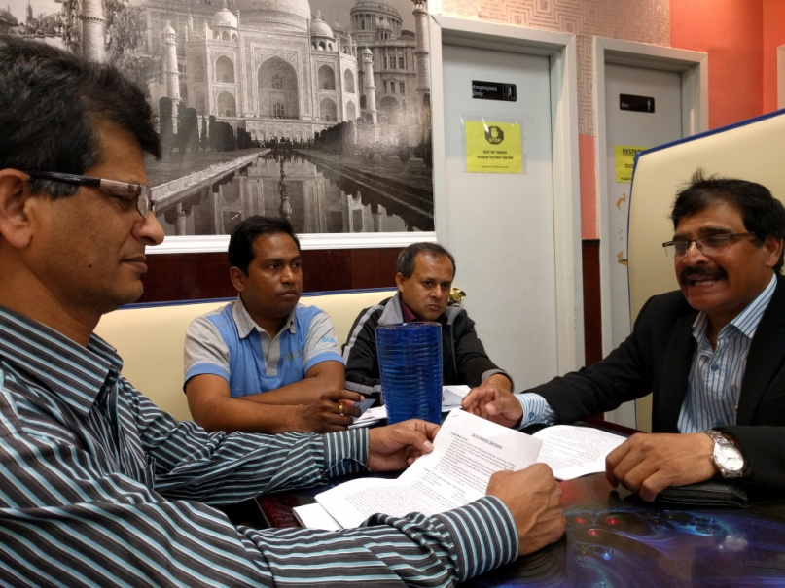

Presentation on Exam Technique ()

Slide 2
Introduction
Presenter
Organizer
Participants

Slide 3
Presentation Goal
Introduction and Overview
Study Materials Book/Guide
Study and Prepare for Exam
Participate in Exam, Follow Rules and Learning
Pass the Exam with Commendable Score

Slide 4
Areas to be covered
Capability, Potential, Attitude, Action (Support, Work, Guide – Me & Dr)
Exam and Recruitment
Testing
Practice Questions Areas (Multiple Choice)
Special Technique - Exams

Slide 5
Soft Issues
Promise to our Keen (Arrival to USA)
Importance of Jobs
Job as Traffic Enforcement Agent
Moving Ladder/Career Progression
Benefit of City Job
Health and Mental Satisfaction

Slide 6
Exam and Recruit
Multiple Choice Exams
Candidate Qualification (education, Paper, Physical)
Candidate List Generation (City)
Interview/Physical/Psychological/Brief Call
Recruitment and Training
Posting to Jobs

Slide 7
Testing Areas
Written Comprehension: These questions will test are you able to understand written sentences and paragraphs.
Written Expression: The test will assess your ability in conveying a clear, written in English message.
Memory questions: Measures your memory for information expressed in words, numbers, pictures and procedures.
Problem Sensitivity: These questions will test how well you identify a problem and its elements, and can you detect an error.
Deductive Reasoning: You’ll be tested on your ability to apply general rules to specific problems and to come up with a logical answer.
Inductive Reasoning: Questions in this test will assess your ability to combine together separate pieces of information or specific answers to problems, thus forming a general rule or conclusion.
Information Ordering: The questions will test your capability to comply with a rule or a set of rules and to arrange things or actions in a certain order. For example, to perform mathematical or logical operations and to arrange numbers, letters, words, pictures, procedures, sentences, etc.
Spatial Orientation: Here you will be tested on your spatial orientation aptitude, meaning the spatial relativity between an object and yourself.
Visualization: The questions measure your visual prediction qualities. To answer these correctly you’ll be required to be able to form mental images of rearrangement and moving around of objects or patterns.

Slide 8
Exam - Memorize
Use your best memorize technique
-Take deep breath
-Snapshot the scene
-See every details and memorize
-Find small clews, letters, no, act, conditions etc
-Memorize
Before exam practice in home few times. Usually 10 questions

Slide 9
Exam Planning
Read details instruction of the test carefully
Identify time according to the number of questions to be answered.
You should try to answer all questions (regardless)
- Allot less time for your favorite and easiest questions
-Try to read questions twice before answer
- Avoid answering in pattern(Example C then D then C (when pattern came to mind change to other type of questions and come back to the left one)
Find the word between the sentence
Find the specific questions they asked for

Slide 10
Find Special Words
Find the requested special words and prepare answer keeping the words in mind
Positive Words: Most, Nearly, Mainly, Wise, Likely, Best, Except, First, Usually, Primarily, Alternative, Principal, Solely, Inversely, Nearly, Generally, Must and many more
Negative words: Poor, Least, Last, Not, Undesirable, Don’t, Unwise
Spot these punch words which are in Bold format and prepare answer according to the punch word. Example: Questions will be which one is the most suitable or which is the least preferable. Always mindful of these punch word.

Slide 11
Best Technique
Utilize full allotted time on the exam. Do not leave early
Allot time for each questions and manage it
In the White Paper Put ABCD for easy answer for Paragraph type questions
Answer your comfort zone first/Answer short questions
If you feel uncomfortable with any questions then leave that for sometime and come back later to answer
Answer mathematical questions (if you feel comfort)
Leave graph/paragraph type questions for later to answer
English or vocabulary questions can be answered as comfort
If you have doubt follow elimination process
If you have time then check your answer (revised/revisit)

Slide 12
Group Discussion
Break for Tea, Group Discussion

Slide 13
Elimination Process
Write in the loose paper (if given by the authority) ABCD fist and from the 4 answer, first take out/cross out the least appropriate 2 answers. Now you have most possible 2 answers and out of this 2 answer 1 is correct. Read second time and circle the most appropriate one which one you think the correct answer. Follow TV series example.
When you revisit the answer, do not change the previous answer easily. Check twice to cross the previous answer.
Try to find answer from the questions, some times answer clue is given in the questions

Slide 14
Example 2 Elimination Process
Billy, at age of two months, is very active and wiggles frequently. The findings of a study on the origins of temperamental or constitutional personality differences would predict that
    Billy will be very quiet and docile by age 5
    Billy will succeed in school
    Billy will very likely be active and unable to sit still for long as a small child
    Billy will be neurotic
    Correct Answer (quoted text)

Slide 15
Exam Preparation
  Book your exam days with center early
  Study the exam guide at least twice
  Have a sound sleep at night
  Please park all your ongoing issues before exam.
  Concentrate on the exams only
  Arrived at least 30 minute early to the center
  After sit down close your eyes and concentrate. Do meditations (if you know)
  Change your seating position when you fell board or sleepy
  Take a few second pause and closed eyes if you feel uncomfortable
  Do not panic. If you panic then you will not be able to concentrate. It is a exam not court room.

Slide 16
Good Luck with Your Exams!
Please feel free to contact me if you have questions, comment or concern at jalilraj@gmail.com.
Tel: 6462879964
Thank You
=============================
Question and Answer
  .

Slide 17
Questions Memorization Test
How many human on the Picture
How many Hut in the Scene
Any water coming from Tube well
How many people in the Bare body
How many people were Glasses
Date of Picture taken
Time of Picture taken
==========
How many cone in the Picture
How many car in the Picture
How many commercial Car in the Picture
How many pole in the picture
What color of the Cap
How many back pack in the Scene
How may walking sign in the Scene

